Slide 1
TianLai FRB Rate Estimate

Slide 2
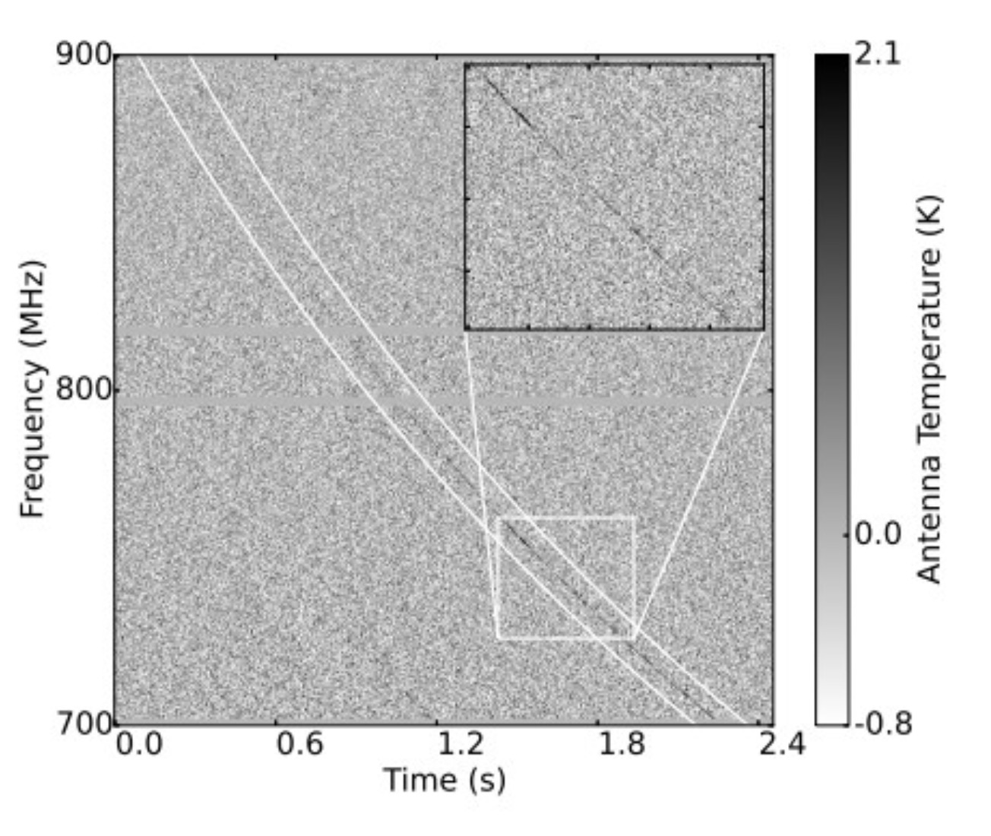
FRB110523 was discovered from GBT off line data.
It was found near 800MHz,and remains the only FRB not found in 1.4GHz.

Slide 3
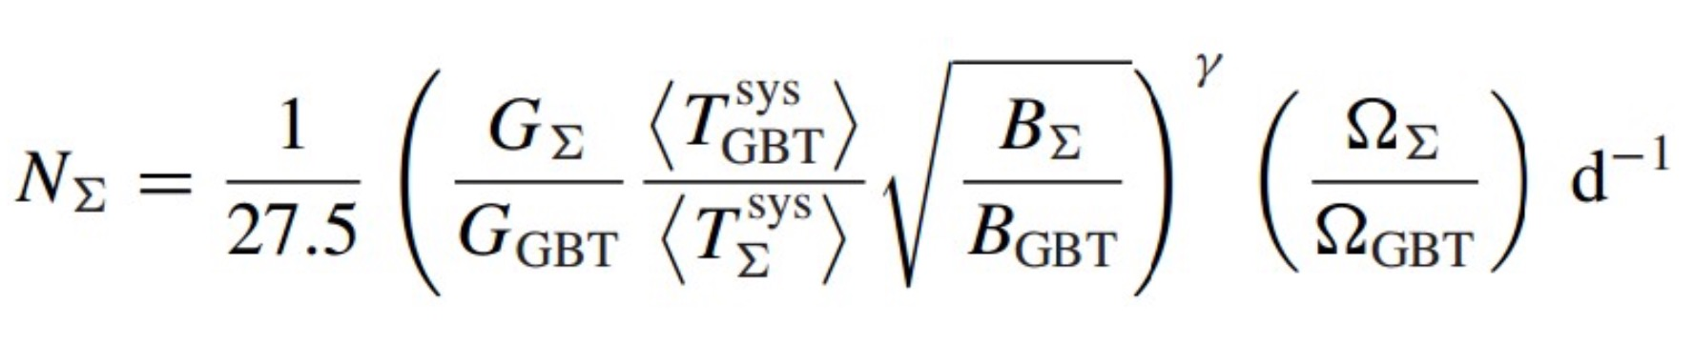
According to this FRB event, Liam Connor etc. estimated the FRB rate of GBT and extrapolate a universal formula for other telescope survey estimate. [MNRAS 460, 1054–1058 (2016)]
Where as N∑ stand for the number of FRB That survey ∑ could observed.
G is the gain depends on the effective aperture and the receive area. Tsys is system temperature. B is the observed bandwidth. Ω is the beam size and γ is depend what universe is. Here We assume γ = 1.5 which stand for a Euclidean Universe. More details in Connor's paper above.

Slide 4
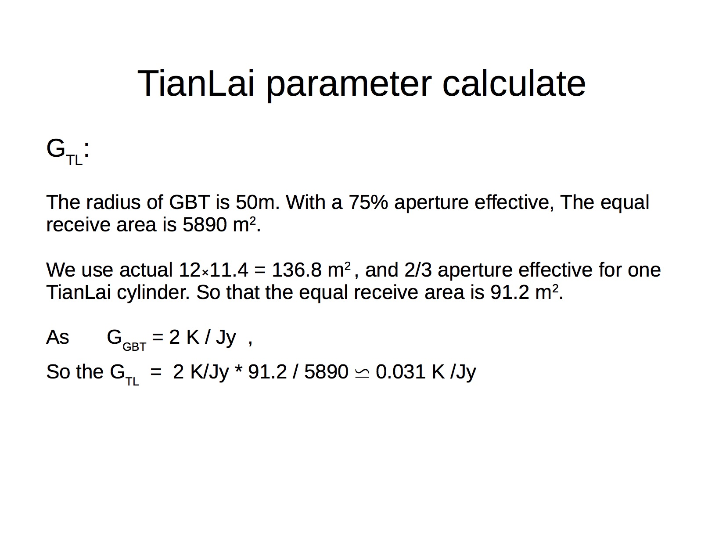

Slide 5
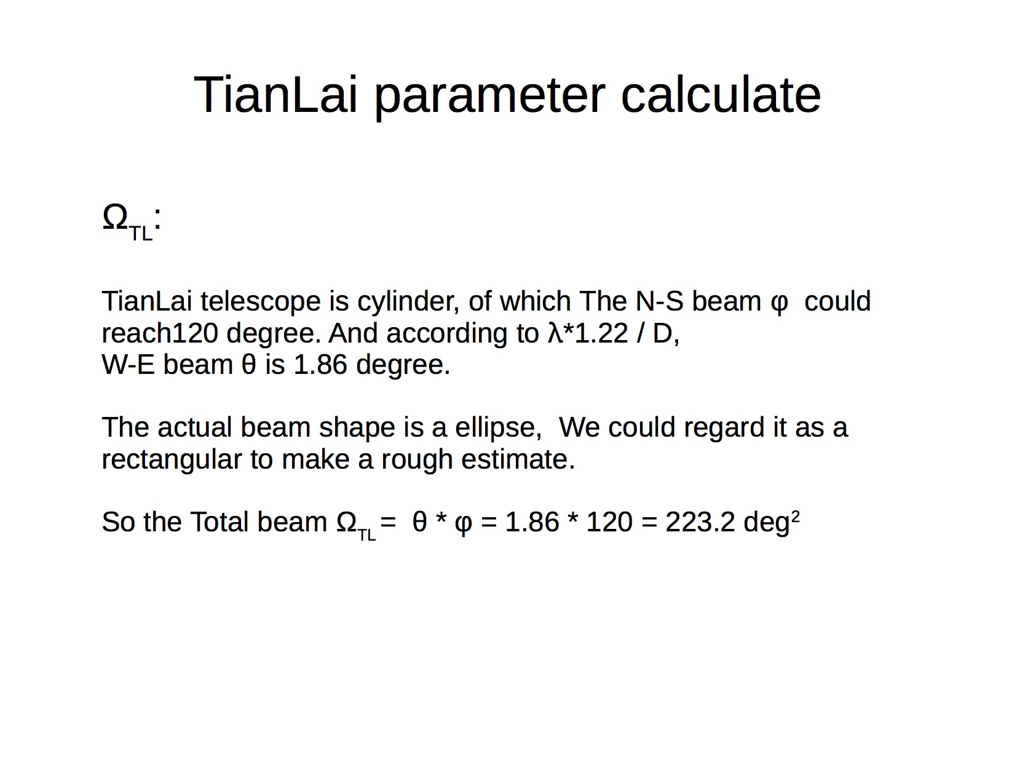

Slide 6
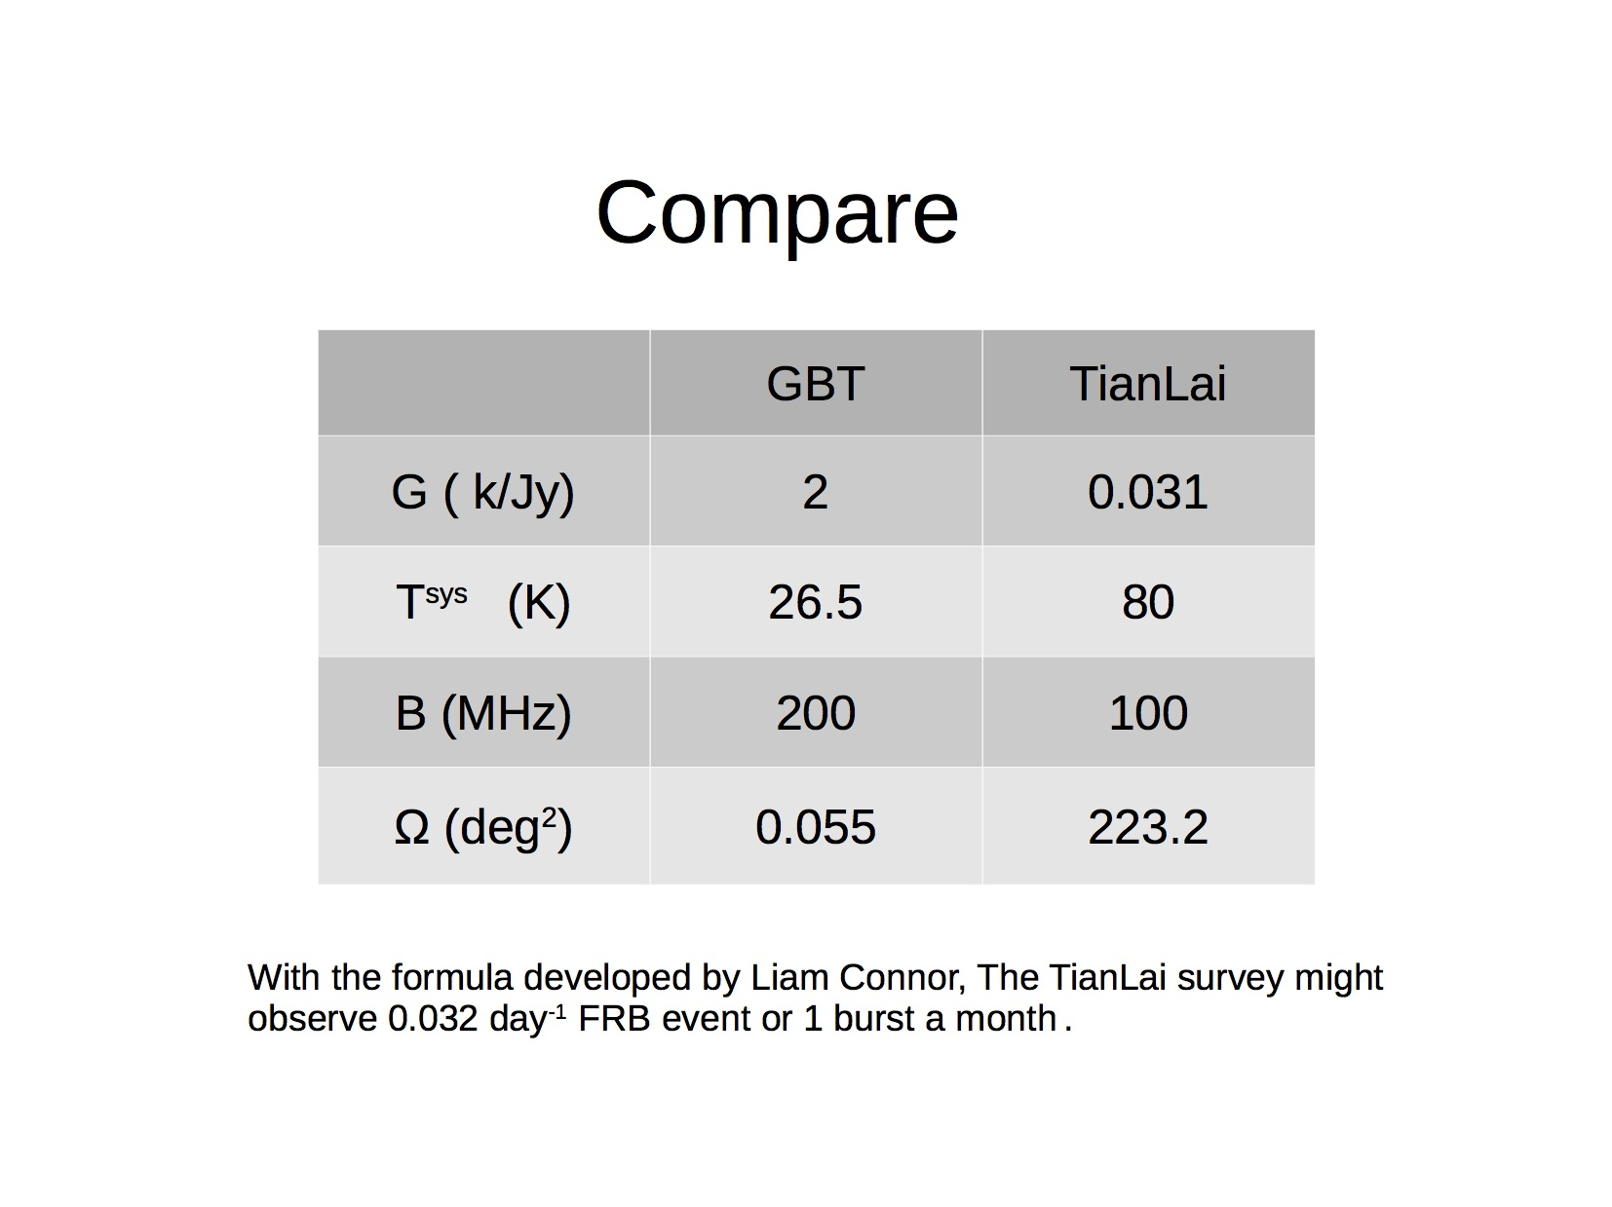

Slide 8
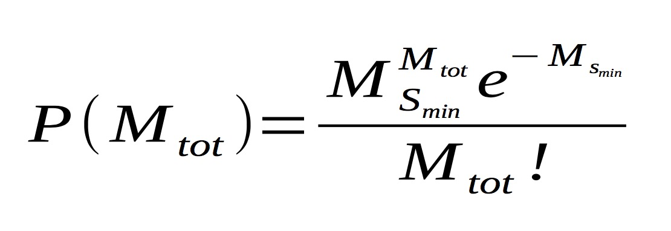
Rate Estimate
Assume the FRB contribute a Poissonian distribution.
MS_{min} is the number of bursts that we expect above the threshold MS_{min}. Thus we can ask which values of MS_{min} make the observed value of M_{tot} most likely. Here we use the expected bursts get from survey compare with GBTIM, M_{tot} = 1/month. Then plot the possibility varied with Ms_{min,}
And draw a threshold 0.05%, above 0.05% is

Slide 9
